Slide 1
What’s New and Cool in Silverlight 5
A tour of Silverlight 5 features

Slide 2
Where to find help
Our Community Sites
silverlight.net
windowsclient.net
asp.net
dev.windows.com
MSDN: msdn.microsoft.com
My Blog: 10rem.net
Will include any updated source/examples
Twitter: @pete_brown
Mail pete.brown@microsoft.com

Slide 3
Tooling
XAML binding debugging
Basic Visual Studio profiling support
Binding and Markup
Implicit data templates
ICustomTypeProvider for dynamic properties
Ancestor RelativeSource binding
Binding in style setters
DataContextChanged event
UpdateSourceTrigger PropertyChanged
Custom Markup Extensions
Text
Linked and multi-column text
Better OpenType support
Pixel-Snapped Text
Tracking/leading control
Media
H.264 hardware decoding
Low-latency sound
Remote-control and Media Key support
Trick-play
System Access
Unrestricted file access for trusted applications
Read/write to Documents without a dialog
P/Invoke for calling native methods
In-Browser Improvements
In-Browser embedded browser
In-Browser trusted applications (group policy)
Controls
PivotViewer Control
Combobox type-ahead and text searching
Multi-click with ClickCount property
Graphics
GPU-accelerated XNA 3D
3D Render targets, XNA effects, pipeline, more
General Performance
Hardware acceleration in windowless mode enabled via new IE9 APIs
XAML parser performance improvements
Network latency performance improvements
Multi-core JIT for improved startup time
Text layout performance improvements
Others
64 bit browser support on Windows
Tasks from TPL
Postscript vector printing
Real windows
LOTS of other fixes and improvements

Slide 4
Binding and Markup

Slide 5
XAML Debugging
Before
Realize binding isn’t working
Hunt through the output window for any binding failure information
Create a debug-only value converter, assign it to all your bindings, and put a breakpoint inside it
Miss lunch, go home late
Now
Set breakpoints in XAML on bindings
Hit breakpoints at runtime just as you would with code
Inspect values, sources, errors etc.

Slide 6
Binding to Dynamic Properties
Before
All object properties must be defined at compile-time
After
Type defined at compile time
Can be a shell type with no properties
Properties added using ICustomTypeProvider at runtime
Supports binding, change notification
Uses
Data-driven and user-configurable systems
Data from RESTful services

Slide 7
Implicit Data Templates
Like regular data templates, but … implicit ☺
Does for templates what implicit styles did for styles
Like implicit styles, tied to a data type
Classes/Structs, not interfaces
Use in any content control or items control
Reuse chunks of UI throughout application - automatically

Slide 8
Regular (Explicit) Data Templates
Data
DataTemplate
Resulting Presentation
class Tweet : TimelineItem {…}
class DirectMessage : TimelineItem {…}
class Notification : TimelineItem {…}
…
TimelineItem[] items = new TimelineItems[]
{
new Tweet(“Pete Brown”, “pete.png”, “…”),
new Tweet(“Jon Galloway”, “jon.png” , “…”),
new Tweet(“Joe Stagner”, “joe.png” , “…”),
new Tweet(“Jesse Liberty”, “jesse.png” , “…”)
};
Pete Brown
Template Assigned to ListBox
Jon Galloway
Joe Stagner
Jesse Liberty
Developer Demo Rule #4705: Twitter must appear in any modern demo

Slide 9
Implicit Data Templates
Data
Implicit Data Templates
Resulting Presentation
Tweet Template
Pete Brown
class Tweet : TimelineItem {…}
class DirectMessage : TimelineItem {…}
class Notification : TimelineItem {…}
…
TimelineItem[] items =
new TimelineItems[]
{
new Tweet(
“Pete Brown”, “pete.png”, “…”),
new Tweet(
“Jon Galloway”, “jon.png” , “…”),
new DirectMessage(
“Joe Stagner”,“joe.png”,“…”),
new Notification(
“Jesse Liberty”,“jesse.png”,“…”)
};
Jon Galloway
DM Template
Joe Stagner
Notification Template
Jesse Liberty

Slide 10
Binding and templates
demo

Slide 11
Other Binding and Markup Enhancements
Ancestor RelativeSource Binding
Binding in Style Setters
DataContextChanged event
Custom Markup Extensions
Update on PropertyChanged

Slide 12
Text

Slide 13
Multi-Column and Linked Text
Flow text from RichTextBlock to RichTextBlockOverflow elements
Link as many as you want
Change from beta which used RichTextBox
Size text elements to work around other elements
Selection works across elements for a transparent experience

Slide 14
Character Spacing
Important for text-heavy layout, headlines and more
Control spacing between characters (Tracking)
Continues to support control of spacing between lines as well
Character Spacing expressed as 1/1000 of font size
Set on anything derived from Control or TextElement

Slide 15
Opentype Support
Ligatures
Contextual Alternatives
Numerical Formats
Fractions
Super/Sub Script
Asian Font Specifics
Much, much more
System.Windows. Typography

Slide 16
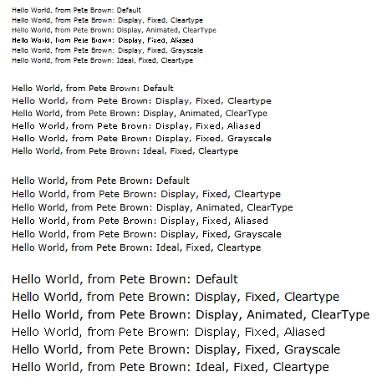
Text Clarity
API Similar to WPF 4
TextOptions.
TextFormattingMode
TextHintingMode
TextRenderingMode

Slide 17
Text Awesomeness
demo

Slide 18
Operating System Integration

Slide 19
Operating System Windows
Past Approach
Use the Popup and ChildWindow classes
Constrained to Silverlight drawing surface
No multi-display support
Silverlight 5 Approach
Popup and ChildWindow still supported and appropriate in some situations
Enhanced Window class for real OS Windows

Slide 20
Real Windows
demo

Slide 21
Platform Invocation (P-invoke)
Just like on the full .NET framework
Elevated Trust applications only
In browser and out-of-browser
Windows Only
Call any compatible native library
Windows APIs
Device and sensor APIs
Your own native DLLs

Slide 22
P-Invoke
demo

Slide 23
Media

Slide 24
Variable Speed Playback and Trick Play
Variable Speed Playback
+32x to -32x speed
Enables Fast-Forward and Rewind without seeking
Trick-Play
Speed up or slow down video without affecting audio pitch
Enabled from 0.5x to 2.0x Speed
Save time watching my tutorials ☺

Slide 25
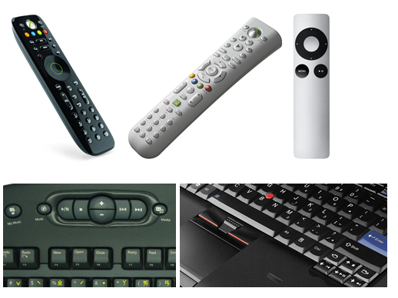
Remote Control and Media Keyboard Support
MediaCommand Event
Not a Command as in WPF
On UIElement
Supports Remote Controls
Supports Media Keys
Mac and PC

Slide 26
Low-Latency Sound
Eliminates circular queues of MediaElements for near-realtime sound
XNA-based API
SoundEffect and SoundEffectInstance classes
Enables playing WAV files
PCM Encoded
8 or 16 bit, mono or stereo
22.5, 44.1 or 48khz sample rate
Other formats will not work, just as in XNA and WP7
Not just for games

Slide 27
Media
demo

Slide 28
Controls

Slide 29
ClickCount
Unlimited click count
Typically used for double and triple click
Multi-click gestures are common
MS Word uses double-click to select word, triple click to select paragraph
Safari 3, Firefox 3, and IE7: triple click selects all text within an element
Silverlight Implementation
Supports 1 to n clicks (42 click easter eggs, anyone? ☺)
Some tricks required if you want both n and n+x clicks (double and triple, for example)

Slide 30
ClickCount
demo

Slide 31
Graphics

Slide 32
3D
A top request from our customers
Ranked 3rd on user voice during SL5 planning
Features split between runtime and SDK libraries
Based on XNA
Suitable for games, visualization, modern interfaces, more
Seamlessly combine 2d and 3d elements
Many improvements in RC and RTM vs. Beta

Slide 33
Runtime Requirements
Shader Model 2.0 GPU
XPDM Driver (XP+) and WDDM (Vista+): User consent or elevated trust required (changed from beta behavior)
Notes:
Shader Model 2-capable GPU required (most machines these days)
To guarantee security and compatibility
Some XP drivers blocked
For permissions: right-click app, choose config and allow

Slide 34
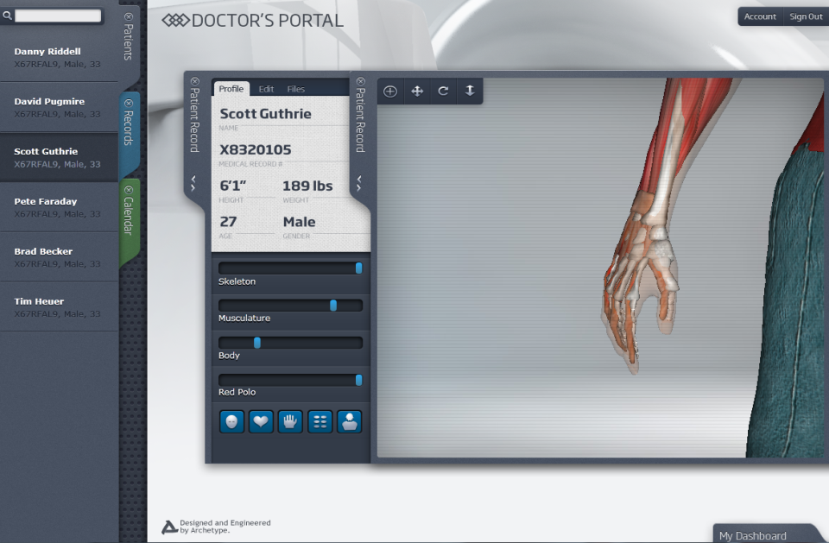
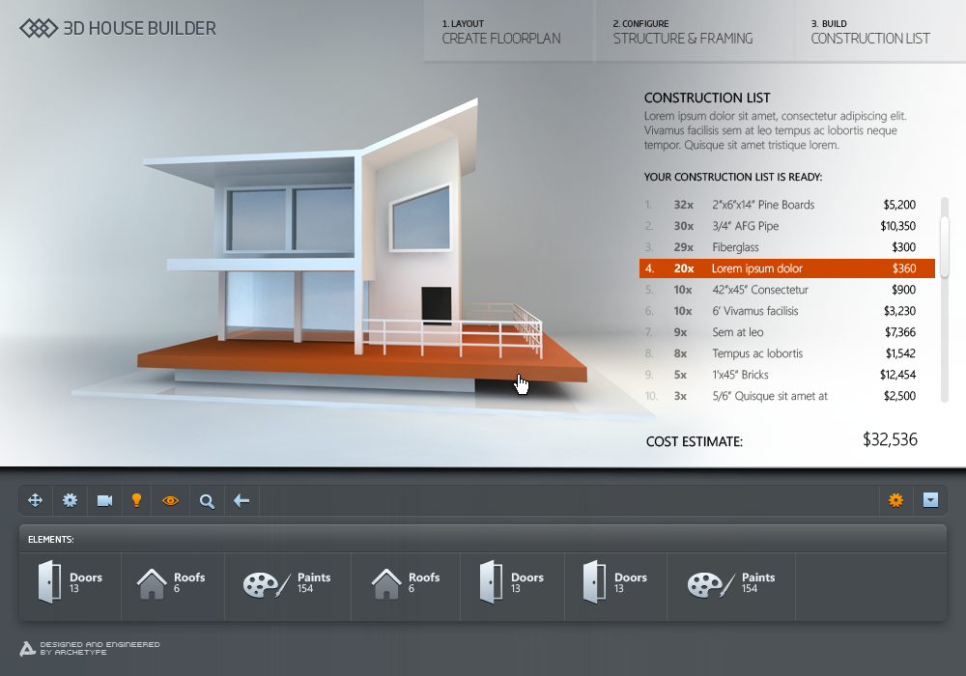
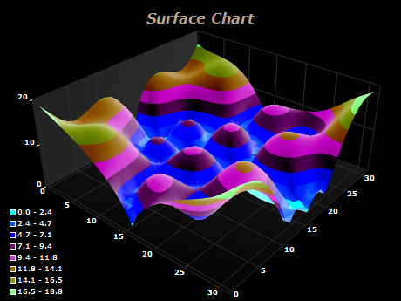
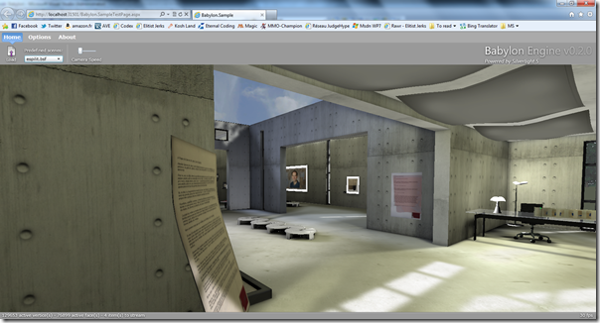

Slide 35
3D
demo

Slide 36
What Next?
Silverlight 5 available now
Shipped in December
Visit http://silverlight.net
Download the bits
Watch the tutorial videos
Walk through the tutorial posts
Build awesome stuff!

Slide 37
Where to find help
Our Community Sites
silverlight.net
windowsclient.net
asp.net
dev.windows.com
MSDN: msdn.microsoft.com
My Blog: 10rem.net
Will include any updated source/examples
Twitter: @pete_brown
Mail pete.brown@microsoft.com

